Slide 1
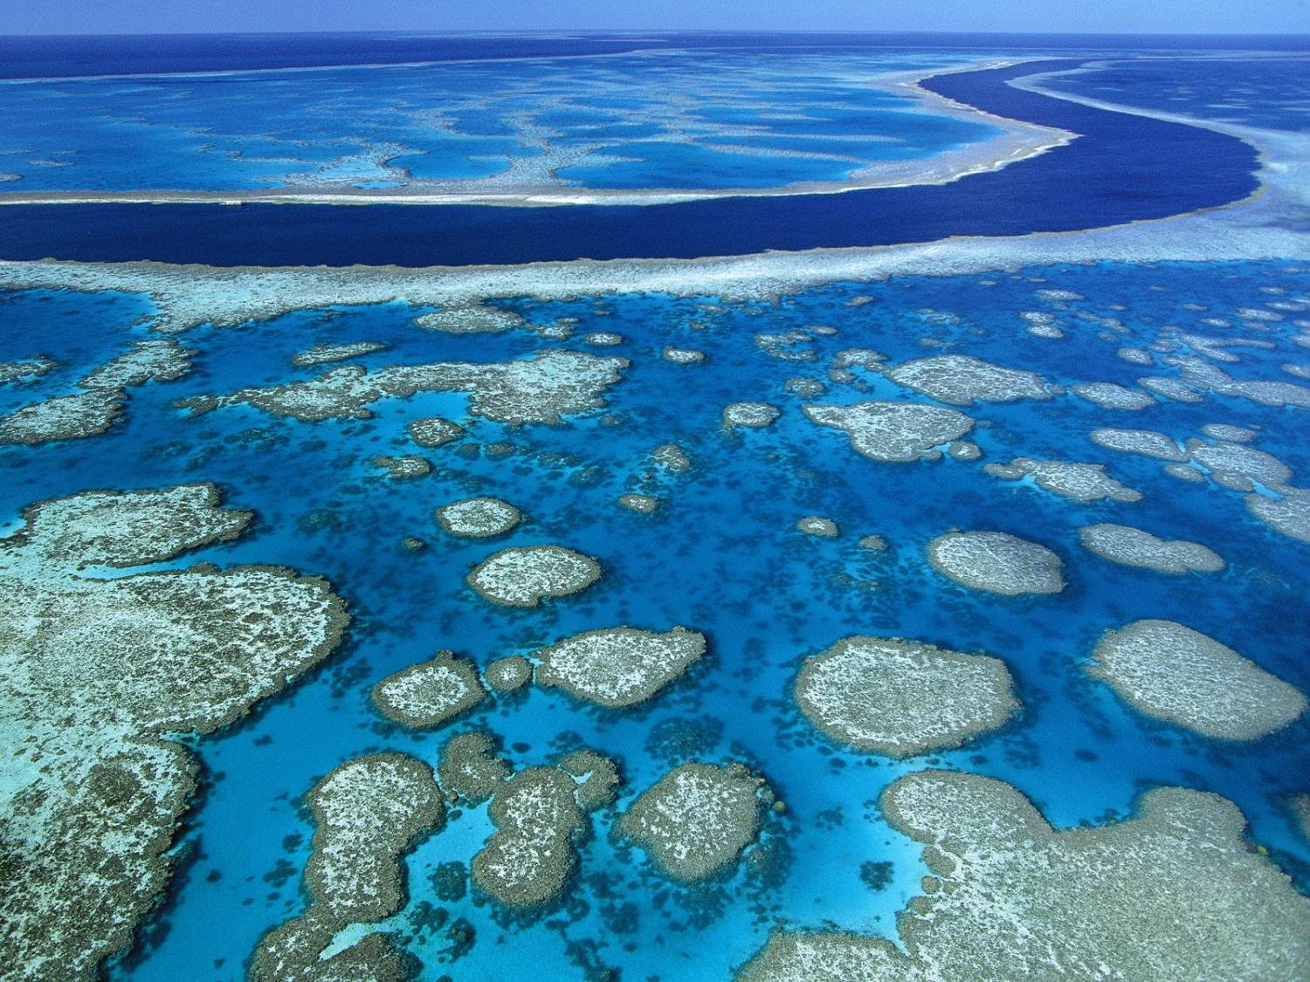
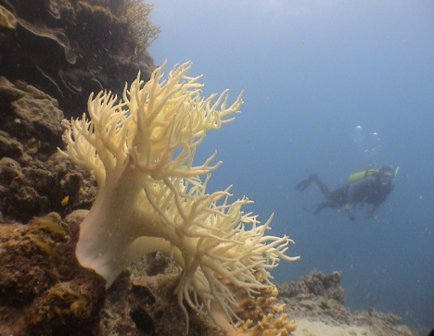
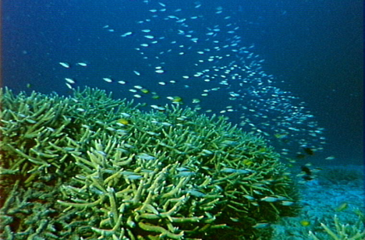
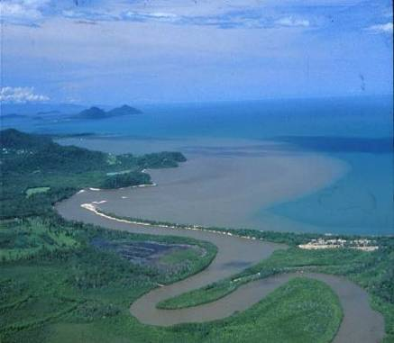
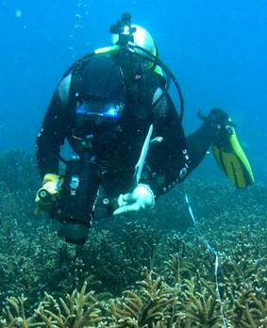
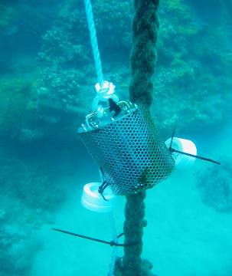
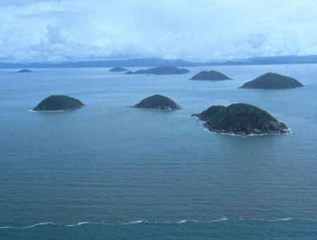
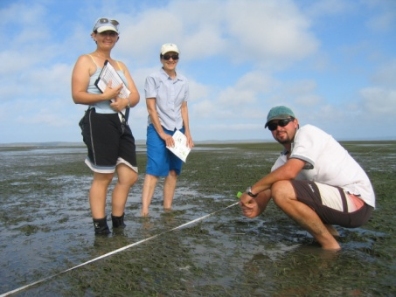
Assessing the effectiveness of water quality management of the GBR: The Reef Rescue Marine Monitoring Program
Katherine Martin (GBRMPA)

Slide 2

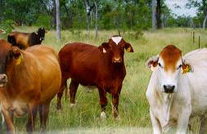
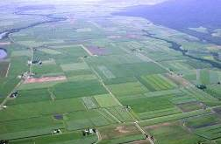
Great Barrier Reef Water Quality Protection Plan (Reef Plan)
Joint Australian and Queensland government initiative to improve land management practices
Goals:
To halt and reverse the decline in water quality entering the Great Barrier Reef by 2013; and
To ensure that by 2020 the quality of water entering the Reef from adjacent catchments has no detrimental impact on the health and resilience of the Great Barrier Reef.
Released 2003
Updated 2009

Slide 3
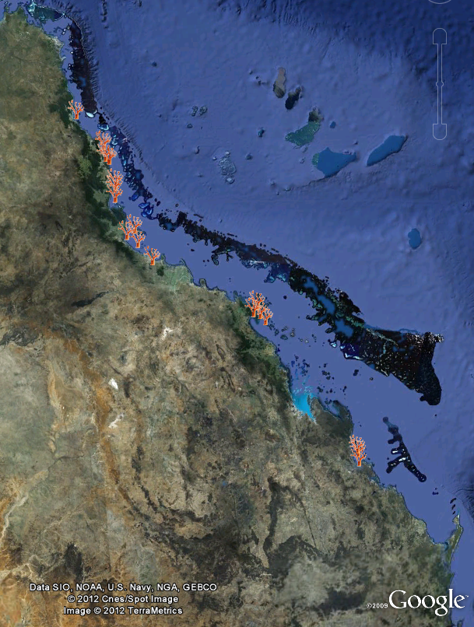
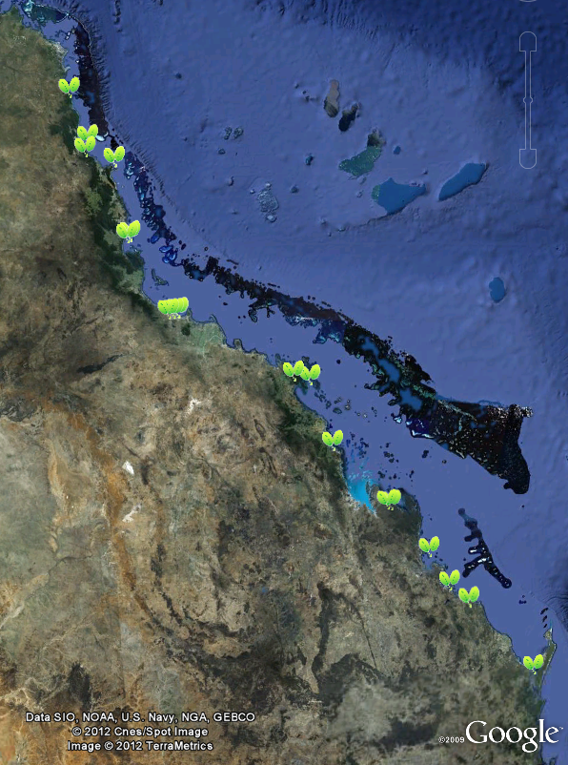
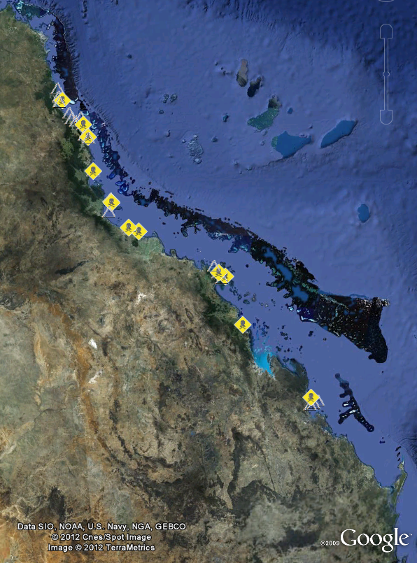
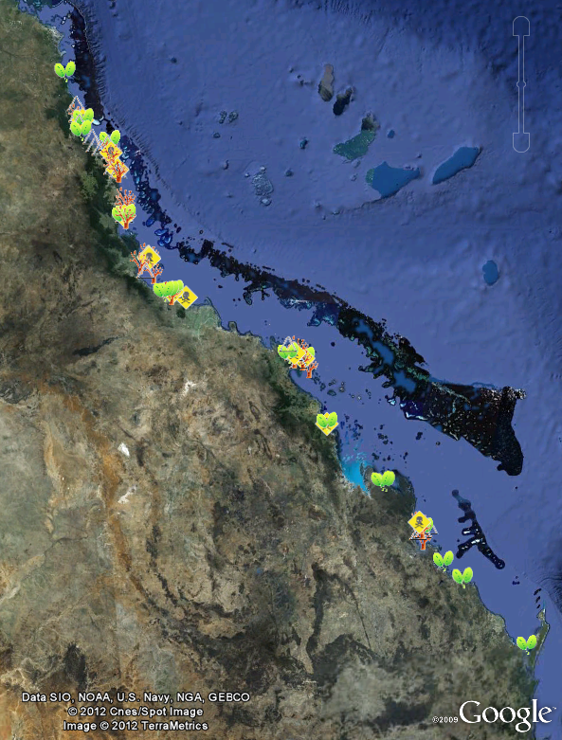
Reef Rescue Marine Monitoring Program
Inshore water quality
Flood plume dynamics
Seagrass meadows
Inshore coral reefs
Assess long-term improvements in water quality and ecosystem health
→ Management effectiveness of Reef Plan and Reef Rescue

Slide 4
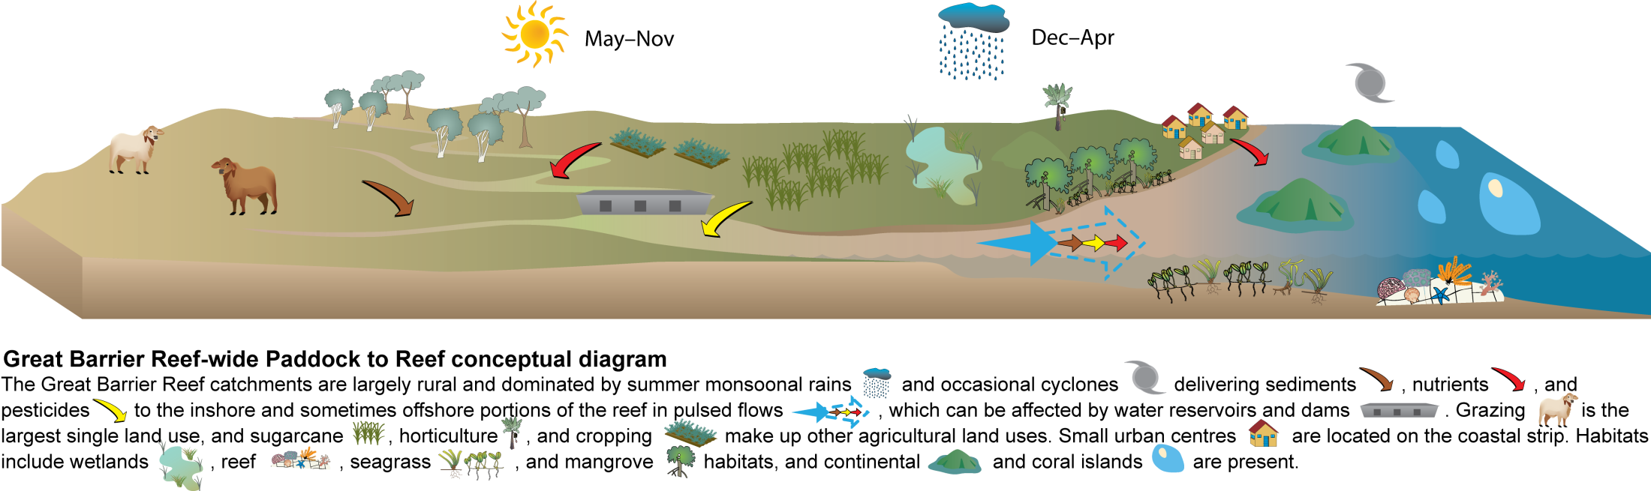
Adaptive management from the Paddock to the Reef
Integrated reporting products
  Metrics for status of water quality, seagrass and corals
  Trends in status over time
  → highlight areas of concern
  → target land management actions
  → revised targets

Slide 5
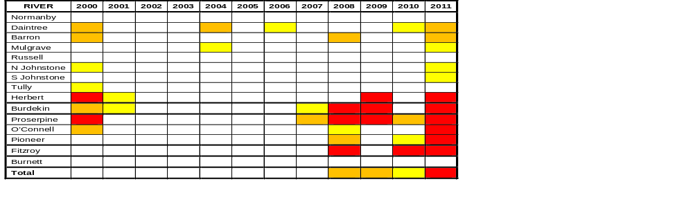
Cumulative impact of flooding
2-3x
~same as record flood in 1994
3rd biggest flood (after 1974 ,1991)
1.5-2x
biggest flood on record
>3x
3rd biggest flood (after 1991, 1974)
biggest flood on record
  La Nina and Pacific Decadal Oscillation
  → A very wet time for the GBR!

Slide 6
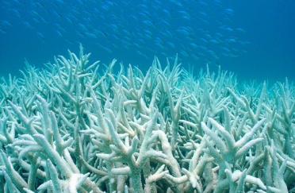
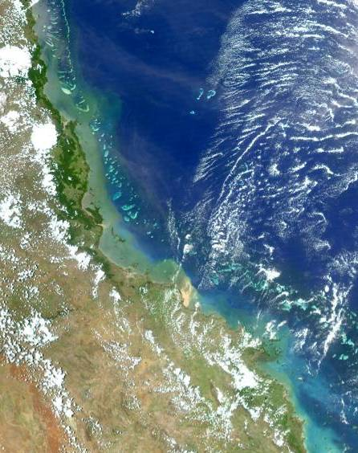
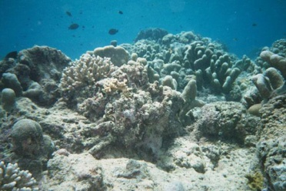
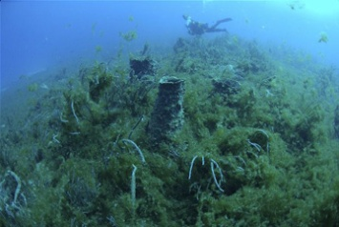
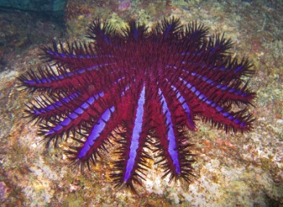
Water quality as a key driver of change
Acute vs. Chronic impacts
FLOOD WATERS
Acute
  large volume of low salinity water
  (long-term average ~70 million ML)
  high concentrations of sediments,
  nutrients, pesticides
Chronic
  - reduced light availability
  - increased macroalgal growth
  increased productivity
  changes to food web (COTS)

Slide 7
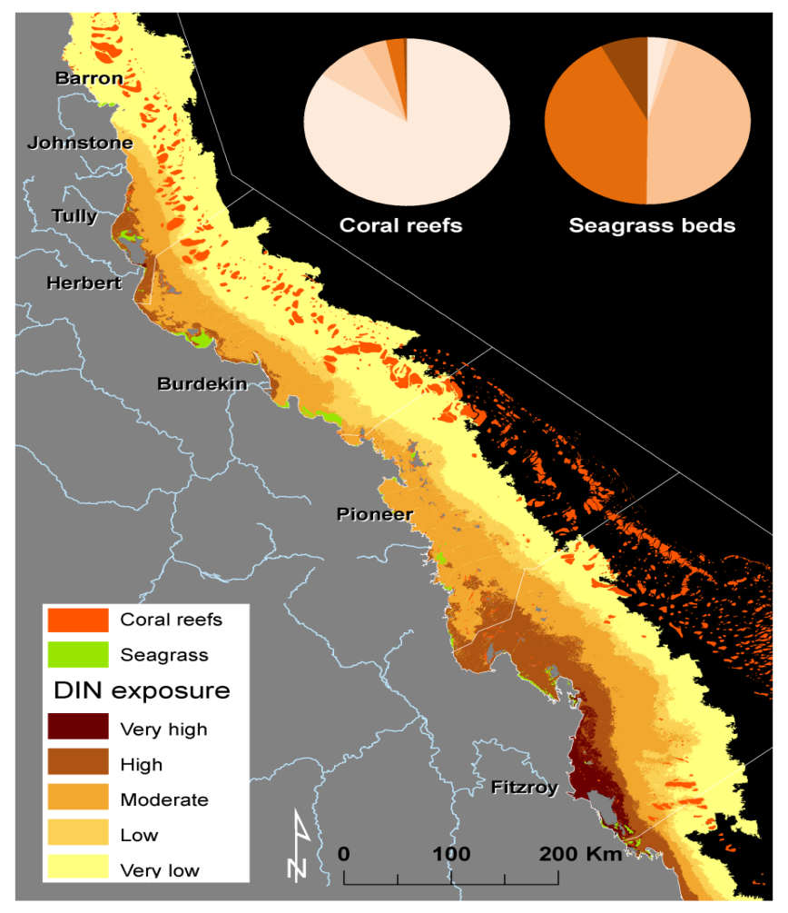
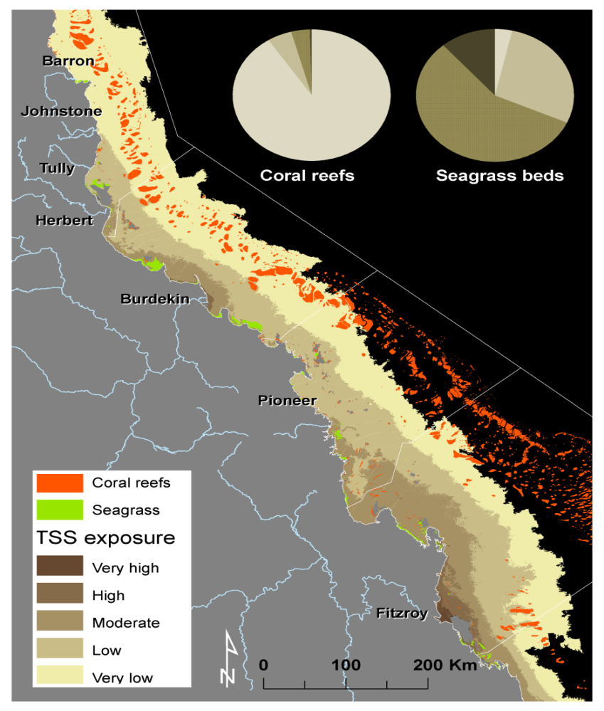
Link with EOC loads to estimate risk of exposure

Slide 8
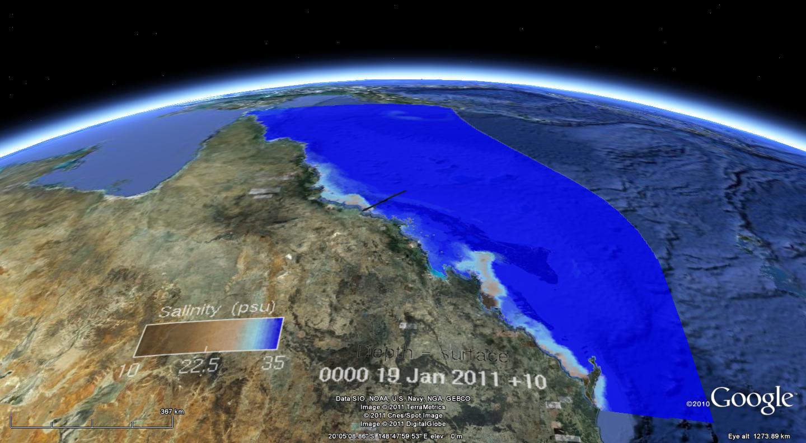
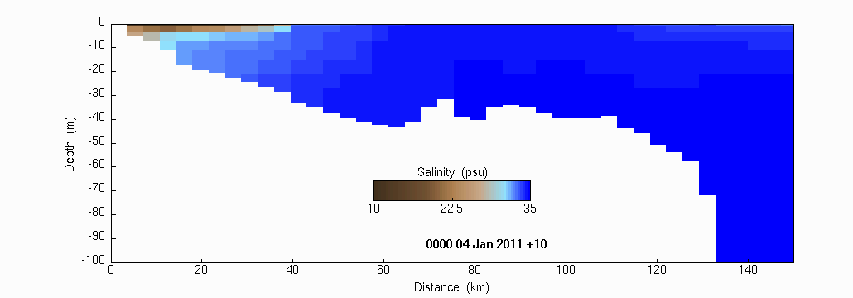
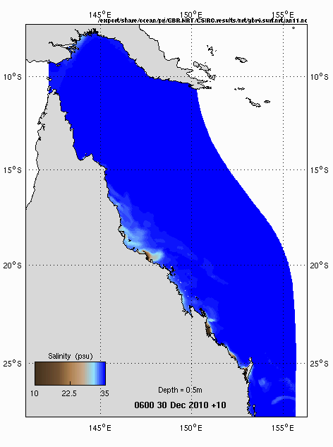
Notes:
Looking at a small period during the most recent wet season, the model now gives us a means to see through the cloud, and map plumes, or at least salinity and see below the surface to add the vertical resolution to augment observational data is available via remote sensing

Slide 9
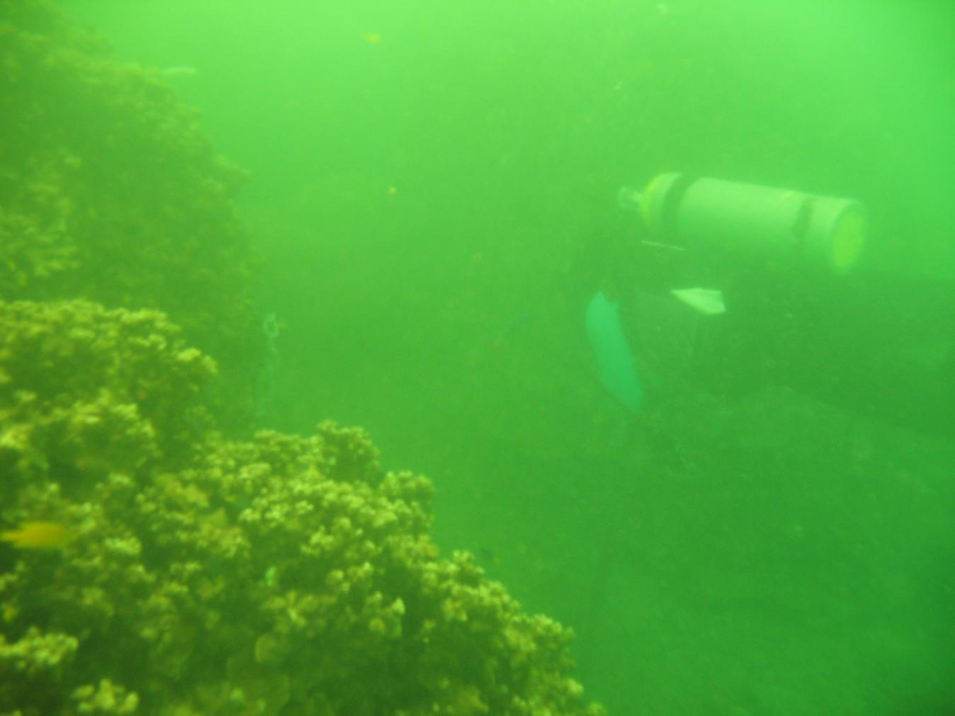
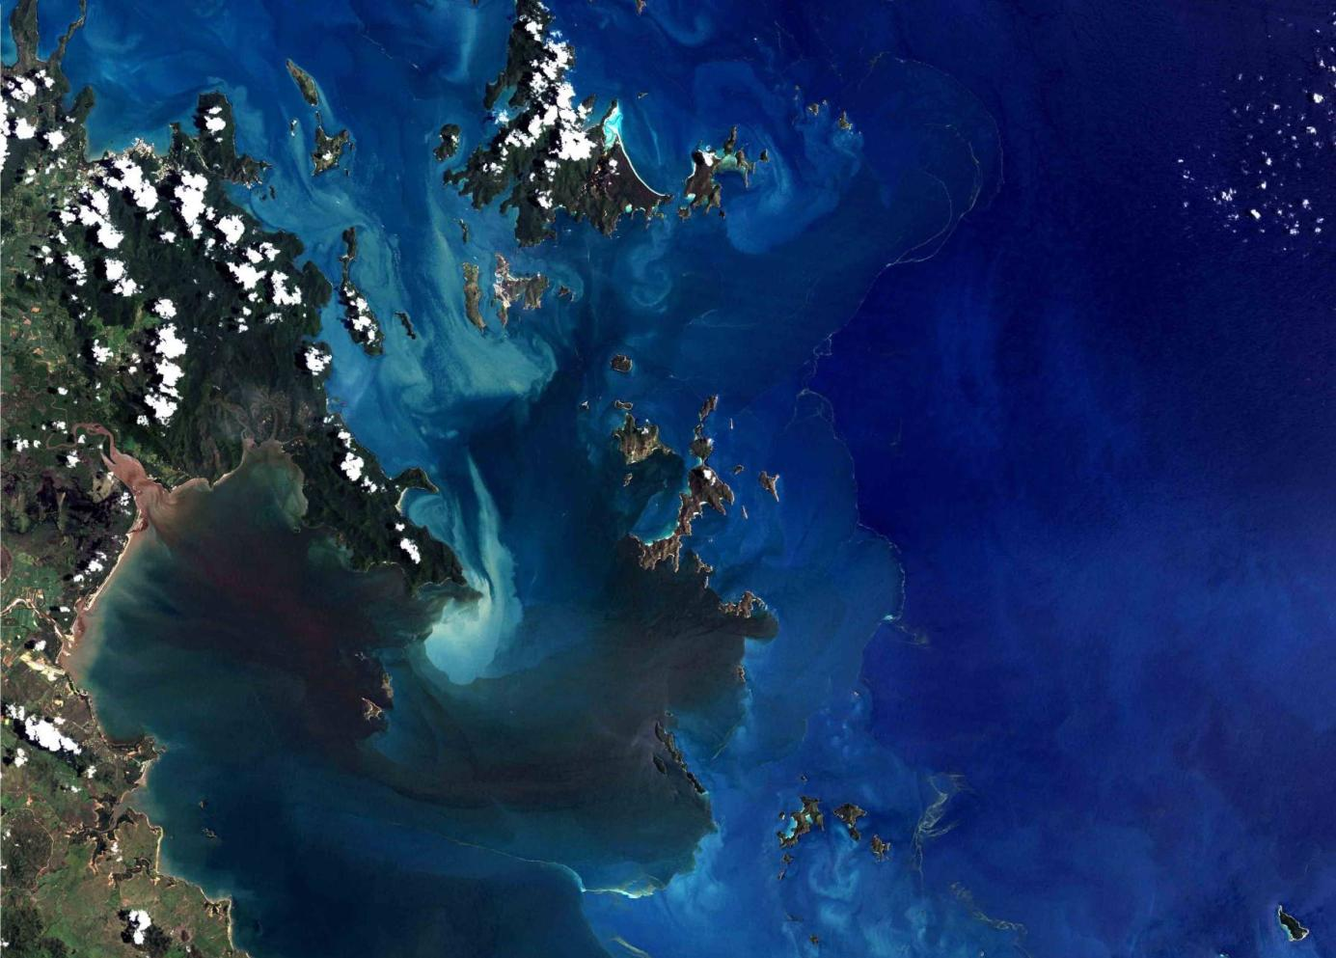
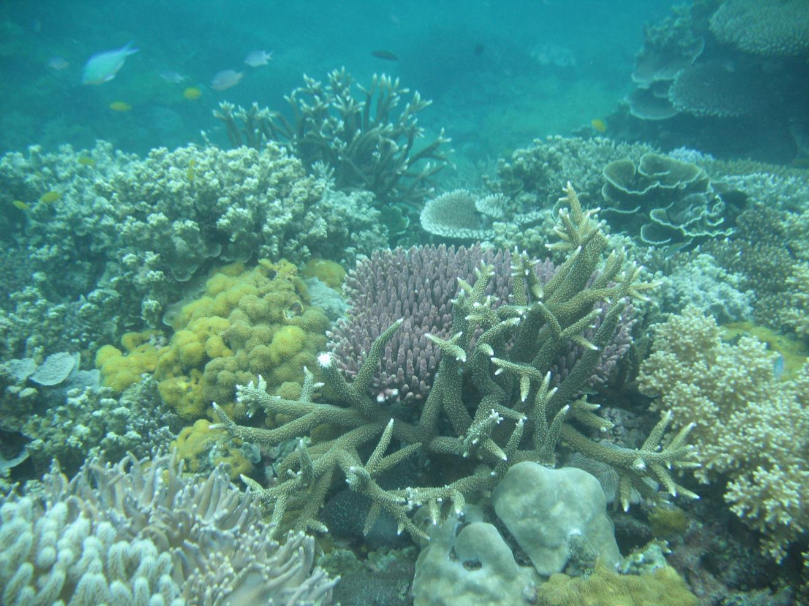
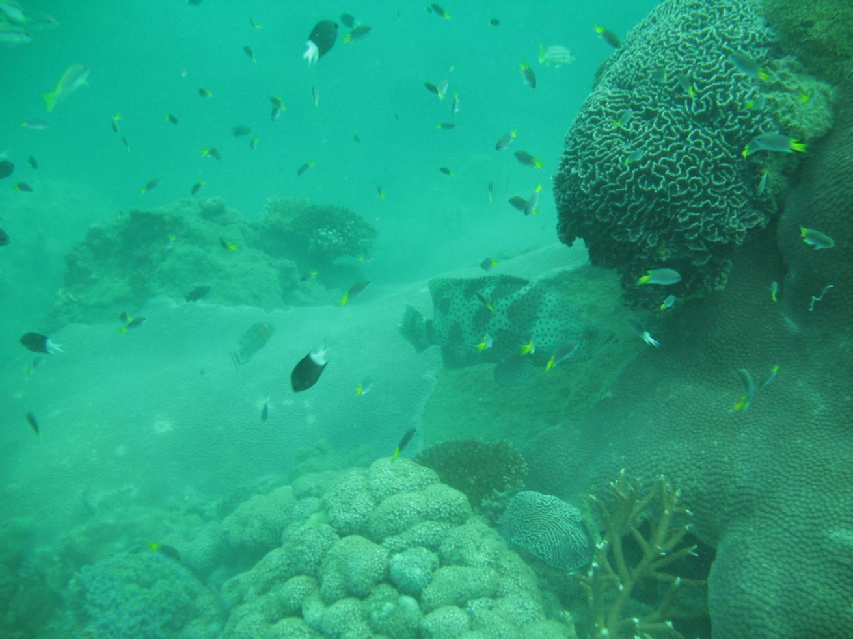
Floods and re-suspension drive the system
Notes:
Most work done in the field – work along clear gradients.
Advantages: environmental relevance, what changes in the field can be further tested in the lab for causality.
However: as most wq variables co-vary, we still have little information on specificity, ie we can’t distinguish between effects caused by sedimentation vs light attenuation etc.

Slide 10
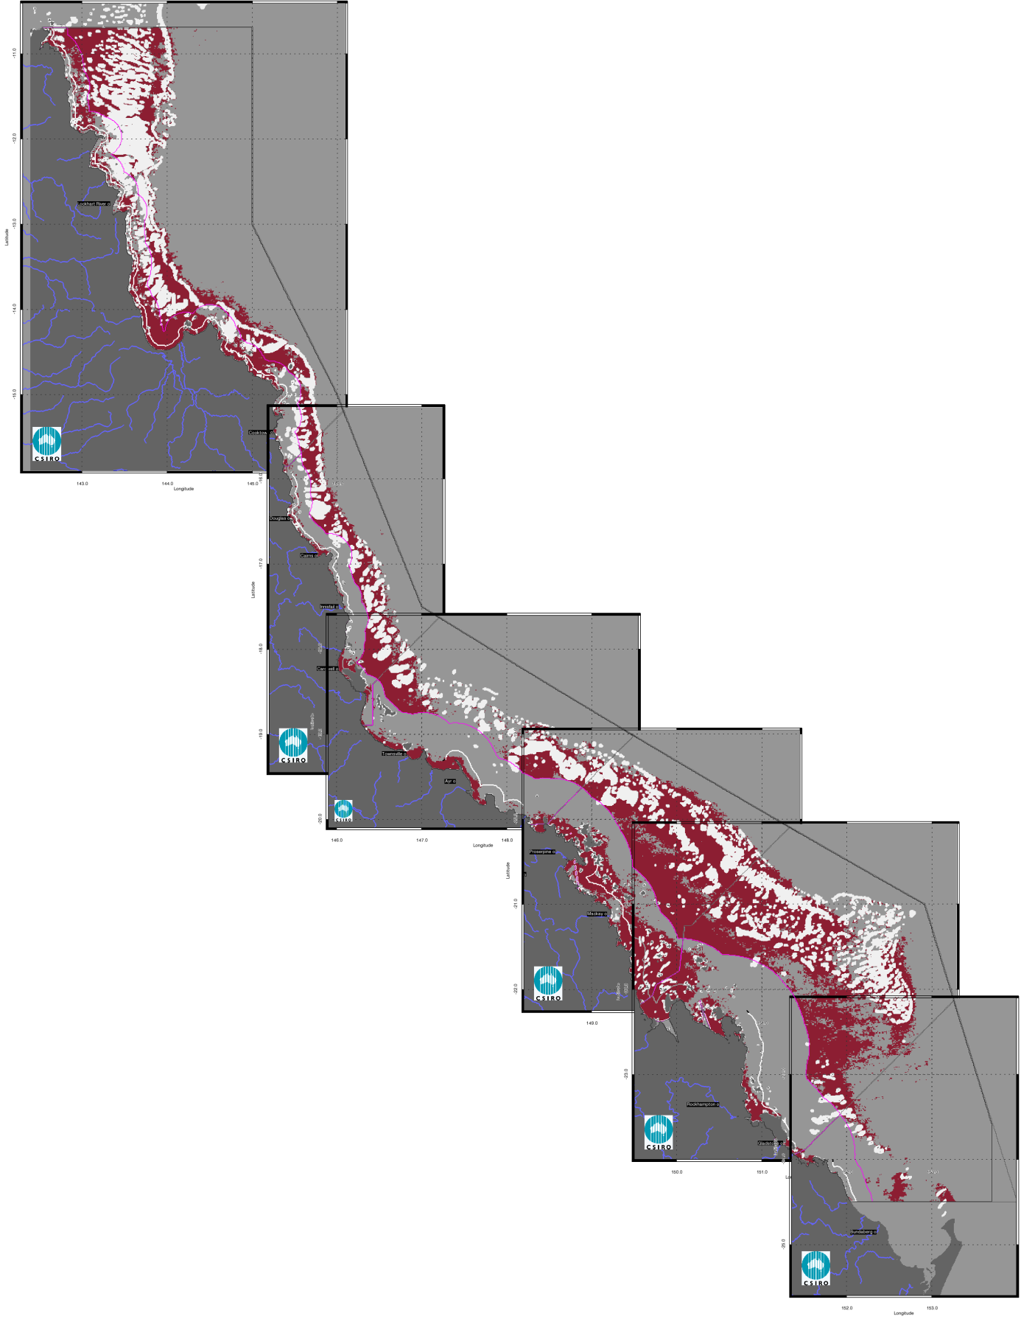
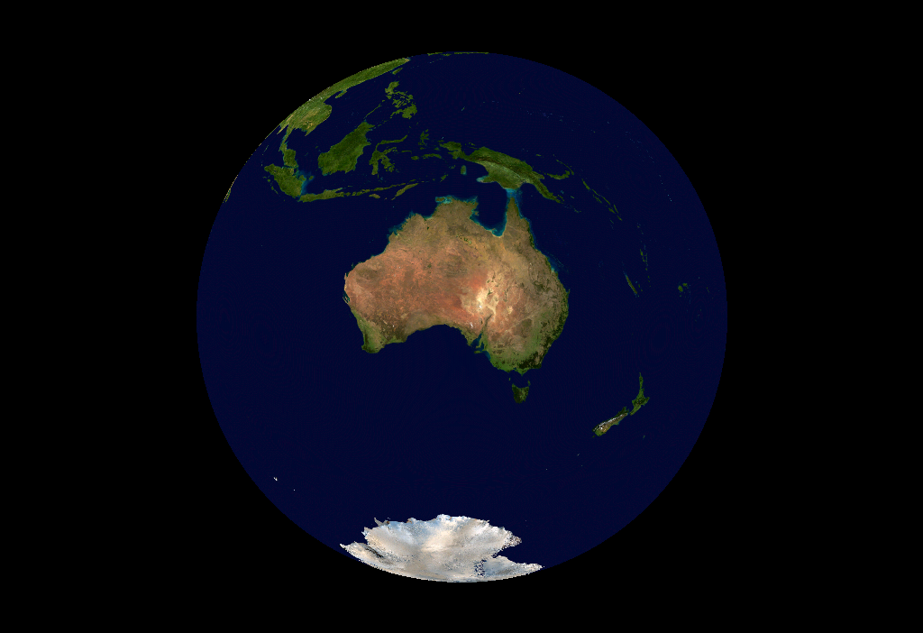
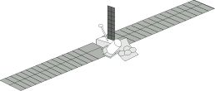
Remote sensing of water quality
Water Quality Guidelines exceeded for chlorophyll and suspended sediments
General trend of increasing turbidity over the past decade

Slide 11
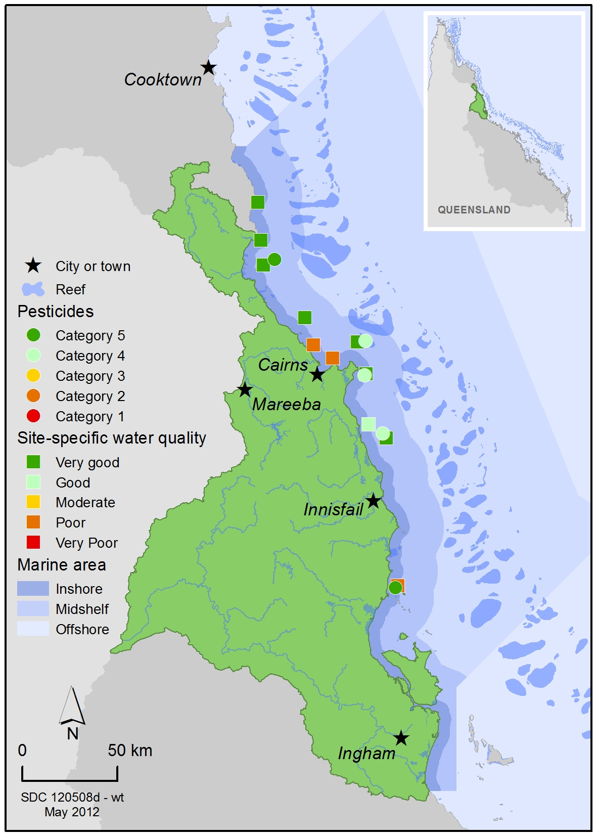
in situ water quality monitoring can identify areas of concern

Slide 12
in situ water quality monitoring can identify areas of concern
Water quality scored
'very good' to 'poor'
Pesticides were category 4
Pesticides were detected at
all sites
Diruon the most prevalent
pesticide
Even low concentrations a
concern

Slide 13
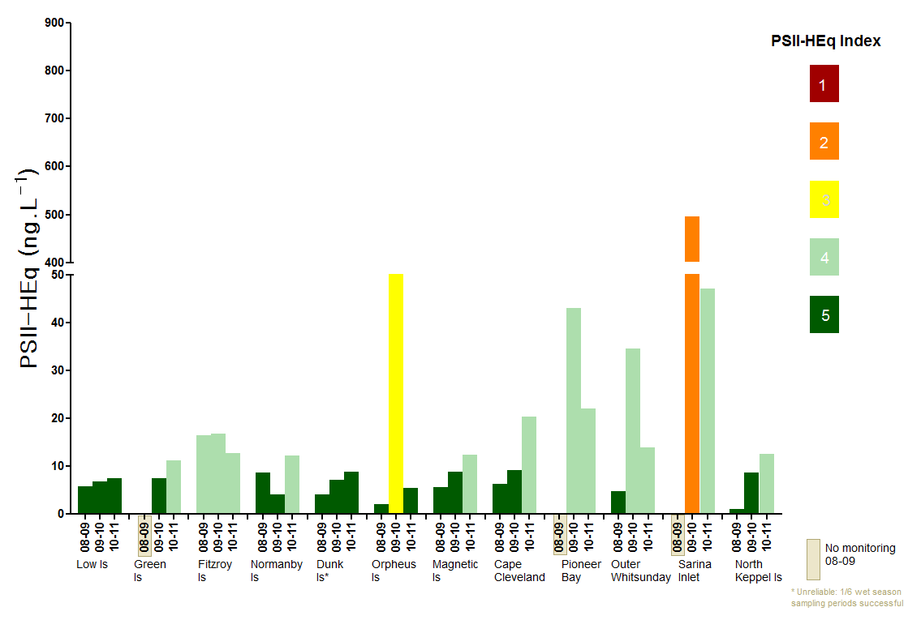
PSII Herbicide Equivalent Index:
an indicator of risk of exposure

Slide 14
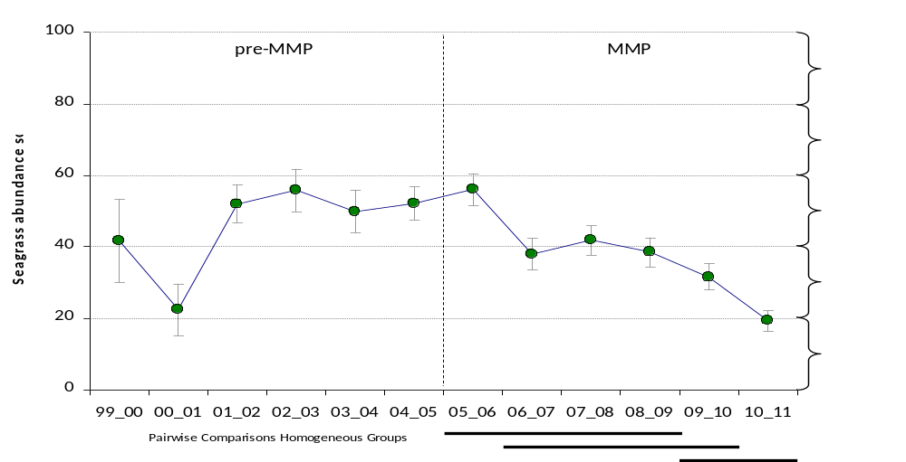
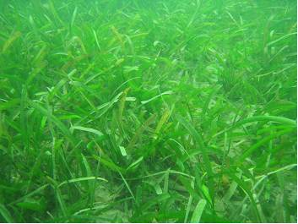
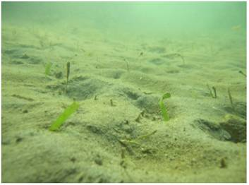
Seagrass is in vulnerable condition across the GBR
Average abundance score (all sites and seasons pooled)
January 2008
Abundance score
February 2011
Declines in abundance, meadow area, reproductive effort,
light availability and evidence of nutrient enrichment at most sites
Notes:
14
Seagrass cover decreasing at intertidal coastal and reef sites since 2009
Post TC Yasi only a few isolated shoots remain

Slide 15

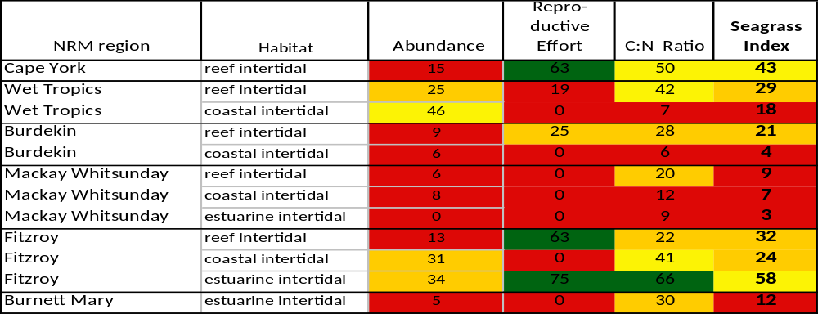
Seagrass status by habitat for each NRM region of the GBR

Slide 16
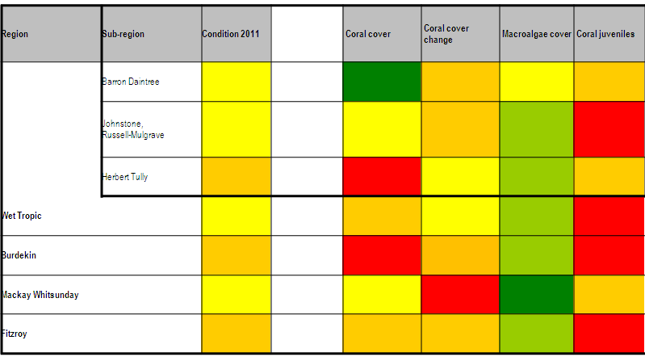
Coral condition
Coral condition
s

Slide 17
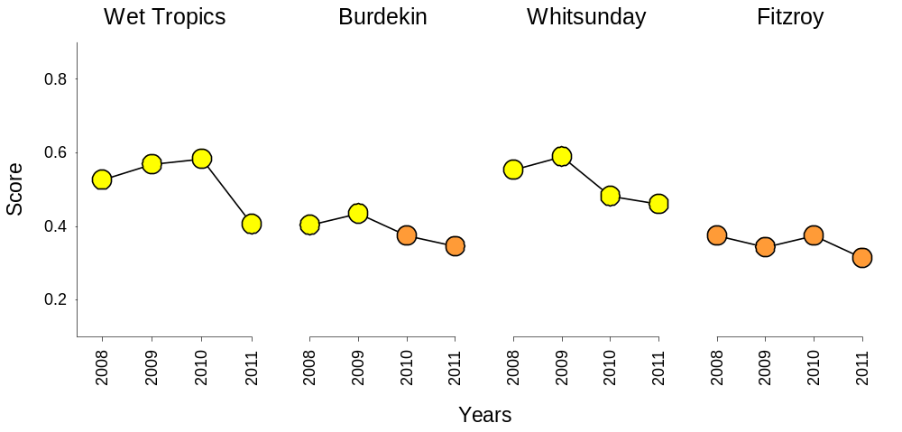
Trends in coral condition
100
80
60
40
20
2008
2009
2010
2011
2008
2009
2010
2011
2008
2009
2010
2011
2008
2009
2010
2011

Slide 18
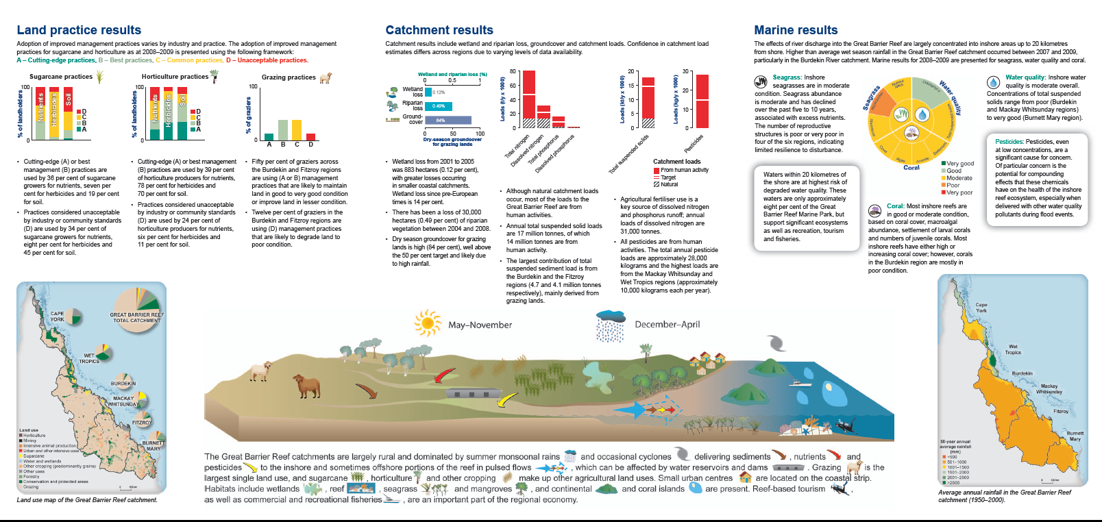
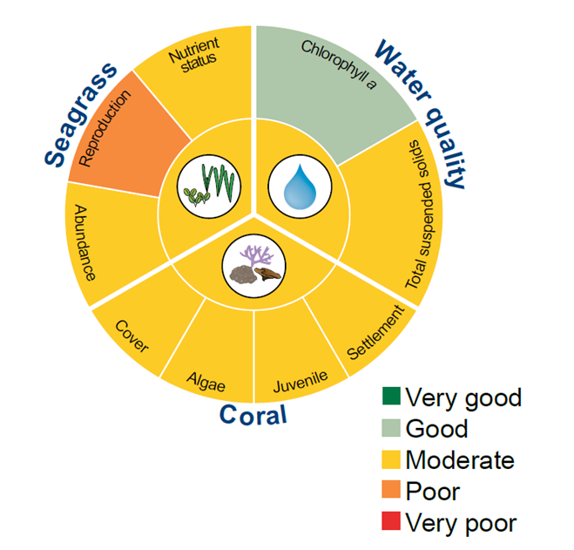
Reef Plan goal is..
"...to ensure that by 2020 the quality of the water entering the Reef...has no detrimental impact on the health and resilience of the Reef"
www.reefplan.qld.gov.au
Notes:
Reef a big place!
Influence of land activities
Put in perspective – RP RR initiatives (funding breakdown)
Connection catchment & reef –P2R
WH area - have to look after it!

Slide 19
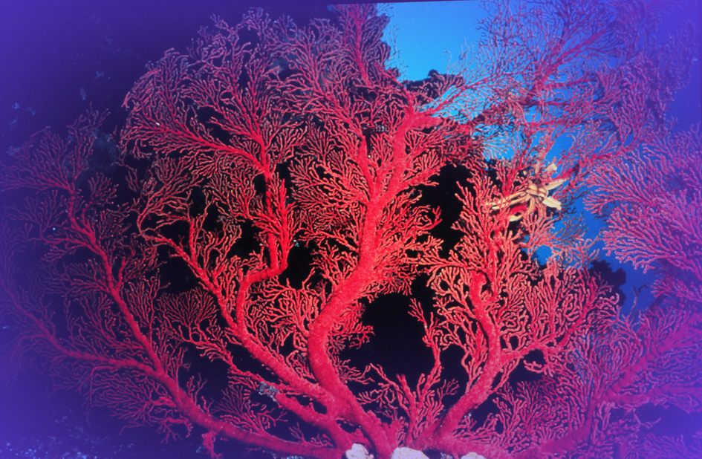
In summary…
Cross-regional framework for coordinated action
The Marine Monitoring Program will detect changes in water quality with changes in land management practices
→ longer time series of data
Challenges include…
→ lag to ecosystem health improvements
→ ensuring metrics reflect changes
We need to continue to act to protect the future of the Reef by improving water quality and enhancing resilience
→ Reef Plan and Reef Rescue

Slide 20
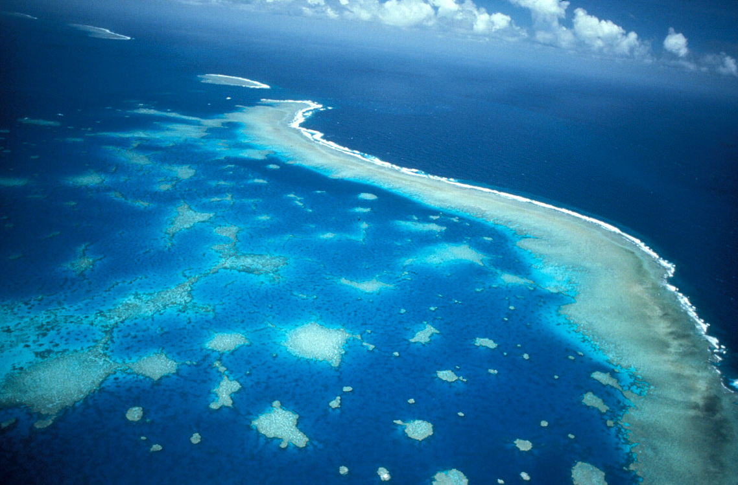
Acknowledgements
AIMS: Britta Schaffelke, Angus Thompson, Richard Brinkman
JCU: Michelle Devlin, Michelle Waycott, Catherine Collier
CSIRO: Vittorio Brando
DPI: Len McKenzie
UQ: Jochen Mueller, Karen Kennedy, Christie Bentley, Chris Paxman
Volunteers deploying passive samplers
DPC: Chris Chinn
GBRMPA colleagues
More details: www.gbrmpa.gov.au

